Slide 1

HITLER’S ASTROLOGER
The true story how the Third Reich used astrology & the occult during World War II
Karl Ernst Krafft
1900 - 1945

Slide 2
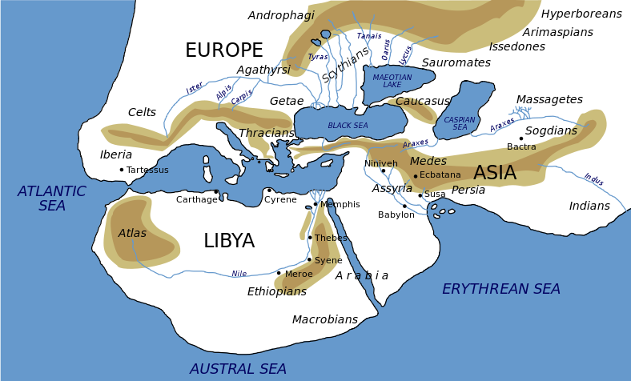
Part 1 - History of Nazi Occult Beliefs
The Mystic Land – first mentioned
Herodotus (450 BC) mentioned the Egyptian legend of Hyperborea – a mystic land far in the north

Slide 3
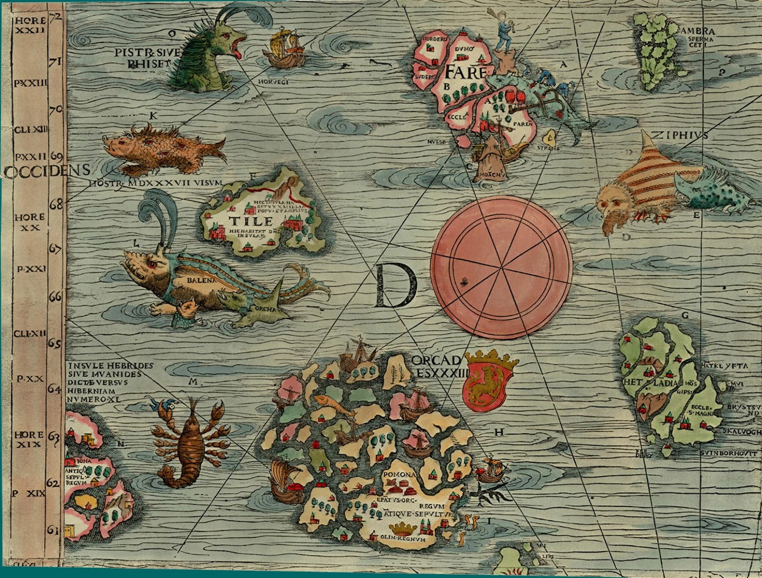
Part 1 - History of Nazi Occult Beliefs
The Mystic Land – first identified
Swedish author Olaf Rudbeck in 1679 identifies Hyperborea near the North Pole, which split into to islands Thule & Ultima Thule

Slide 4
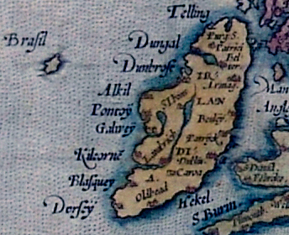
Part 1 - History of Nazi Occult Beliefs
The Mystic Land – Hy Brasil
In Irish myths, Hy Brasil was said to be cloaked in mist,
except for one day every seven years,
when it became visible, but still could not be reached.

Slide 5
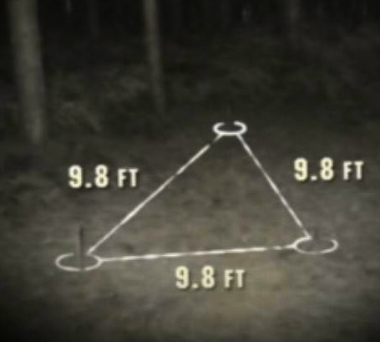
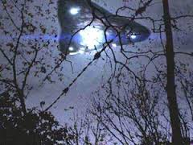
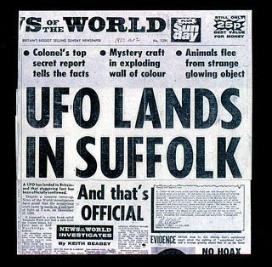
Part 1 - History of Nazi Occult Beliefs
The Mystic Land – identified by UFO
In Rendlesham Forest (1980) Sgt. James Penniston at RAF Woodbridge Base experienced a telepathic download of binary data when he came in contact with what appeared to be a strange craft.

Slide 6
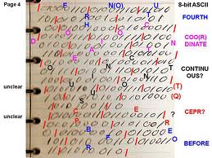
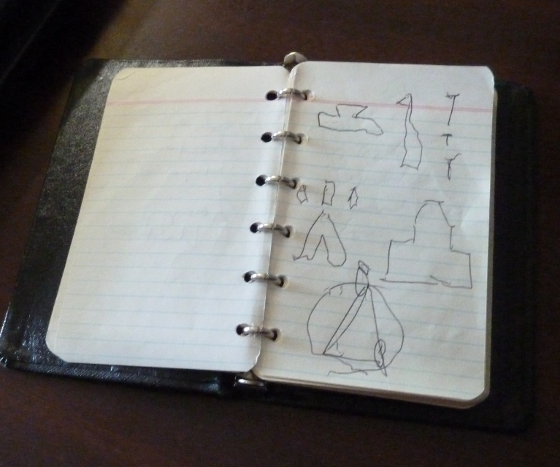
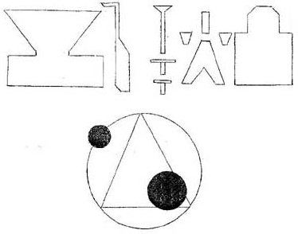
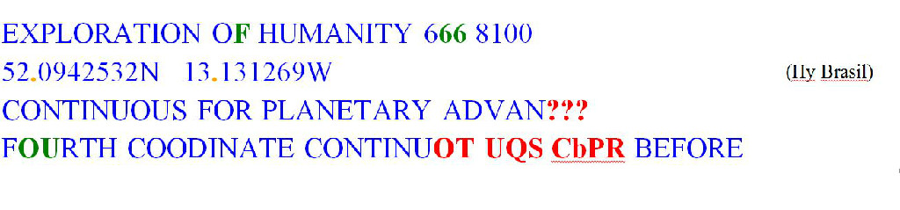
History of Nazi Occult Beliefs
The Mystic Land – identified by UFO
Dozens of USAF personnel at RAF Base Woodbridge were eyewitnesses to this
UFO event and is considered “Britain’s Roswell”.

Slide 7
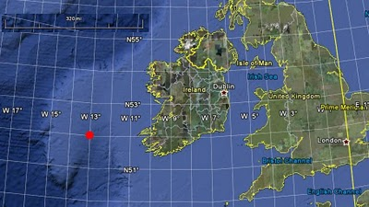
Part 1 - History of Nazi Occult Beliefs
The Mystic Land –ID’ed in modern times
52’00” N, 13’00” W appears to be significant in ancient & modern times

Slide 8
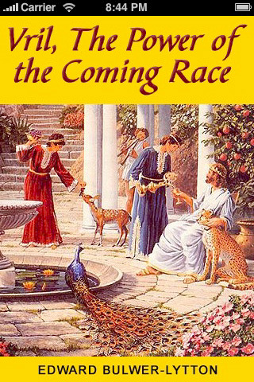
Part 2 - History of Nazi Occult Beliefs
The Hollow Earth
British astronomer Sir Edmund Halley first suggests earth is hollow, with four concentric spheres
Jules Verne (1864) writes Voyage to the Center of the Earth
Britain’s Edward Bulwer-Lytton
writes “The Coming Race”
(1871) on a subterranean
human like race called the
“Vril-ya”

Slide 9
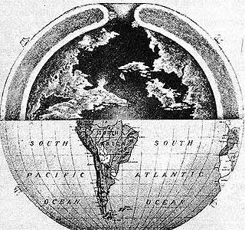
Part 2 - History of Nazi Occult Beliefs
The Hollow Earth
Lytton describes the Vril-ya race as living beneath the earth & planned
to conquer the world using
VRIL
a psychokinetic energy.

Slide 10
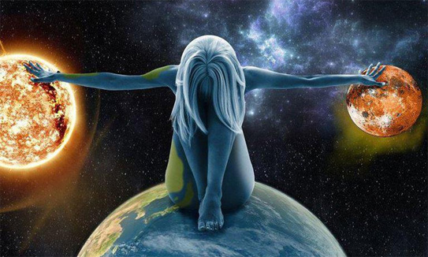
Part 3 - History of Nazi Occult Beliefs
The Energy – Vril
French author Louis Jacolliot pens The Sons of God (1873) & The Indo-European Traditions (1876):
Links Vril with subterranean people of Thule
Links Vril power with superior beings
Introduces idea of ‘super race’ that will conquer the world.

Slide 11
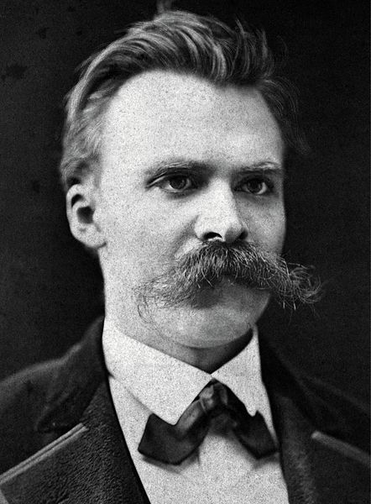
Part 4 - History of Nazi Occult Beliefs
The German Interpretation
Friedrich Nietzsche (1844 – 1900):
German philosopher introduces & famous for PERSPECTIVISM –
no way of seeing the world can be taken as definitively "true"
Der Wille zur Macht – “The Will to Power”
The main driving force within humans – the
more power – the more superior the human
Suffered a mental breakdown in 1889 – cared
For by sister Elisabeth, whose husband, an
anti-Semite & nationalist altered his unfinished
works & published showing Nietzsche favoring
militarism and eventually Nazism themes

Slide 12
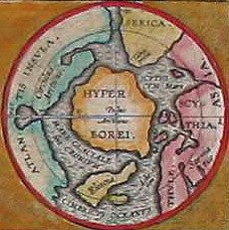
Part 4 - History of Nazi Occult Beliefs
The German Interpretation
Early 20th Century Philosophical Ideas
Lost Land
of a past
superior race

Slide 13
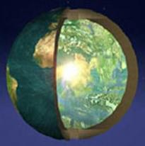
Part 4 - History of Nazi Occult Beliefs
The German Interpretation
Early 20th Century Philosophical Ideas
Hollow
Earth

Slide 14
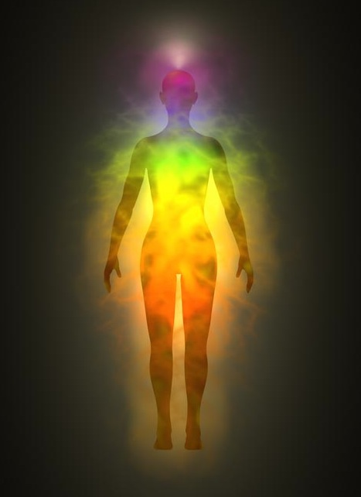
Part 4 - History of Nazi Occult Beliefs
The German Interpretation
Early 20th Century Philosophical Ideas
Controllable
energy
within all
things:
VRIL

Slide 15

Part 4 - History of Nazi Occult Beliefs
The German Interpretation
Early 20th Century Philosophical Ideas
Control of Vril
will revitalize
descendants of lost race of Thule to
super humans

Slide 16
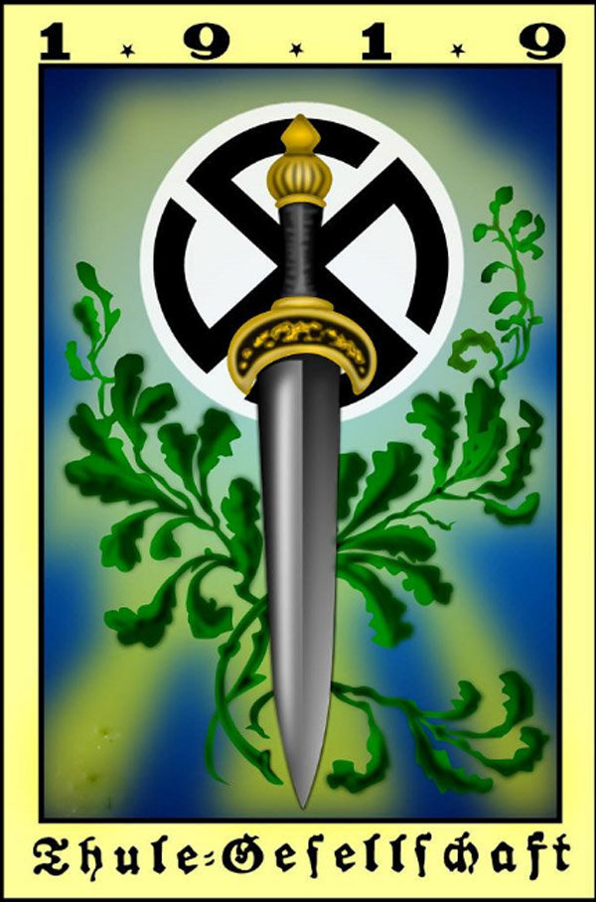
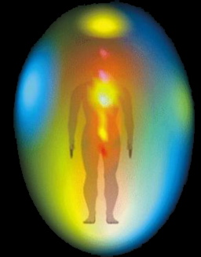
Part 4 - History of Nazi Occult Beliefs
The German Interpretation
These ideas develop of two Societies:
Thule Society Vril Society

Slide 17
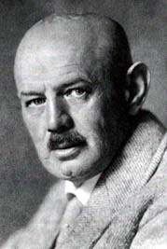
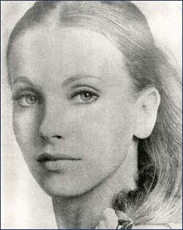
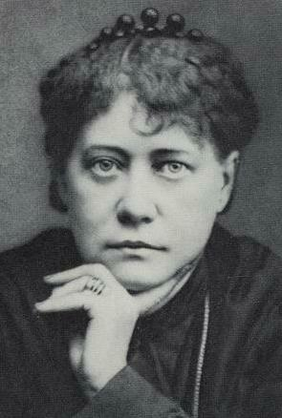
Part 4 - History of Nazi Occult Beliefs
The Nazi Interpretation
Thule Society + Vril Society = Nazi Beliefs
Dietrich Eckart Maria Orzich Helena Blavatsky

Slide 18
Part 4 - History of Nazi Occult Beliefs
The Nazi Interpretation
Dietrich Eckart (1868 – 1923)
- Journalist / Politician / Playwright
- Anti-Semite / early member of Nazi party
- Member of Thule society
Believed Maya (Hindu) & Vril were same power
Believed Aryans migrated from Hyperborea to
Tibet / northern India
Blamed Social Democrats/Jews for WWI defeat
Major influence on Hitler & made many
major introductions that assisted Hitler’s rise to power
Hitler dedicated Mein Kampf to Eckart
Influenced the Nazi salute to have spiritual practice from ancient India

Slide 19
Part 4 - History of Nazi Occult Beliefs
The Nazi Interpretation
Maria Orzich (1895 - ????)
- Associated with Thule Society
- Started “Alldeutsche Gesellschaft für Metaphysik”
Beauty & Hair
Met with Eckart & Rudolf Hess in November 1922
In trance, wrote ancient Sumerian characters
Contacted race of beings from Aldebaran
Called Sumi, ancestors of Aryans – masters of Sumer
Corrected stated it was 68 light years from earth
Her page on Wikipedia was deleted

Slide 20
Part 4 - History of Nazi Occult Beliefs
The Nazi Interpretation
Helena Blavatsky (1831 – 1891)
Secret Doctrine – channeled from ancient ‘mahatnas’ – Hyperborea: root race
One Divine substance: religion to science
Eastern idea of ‘illusion’ (everything is
temporary)
Different levels of consciousness/existance

Slide 21
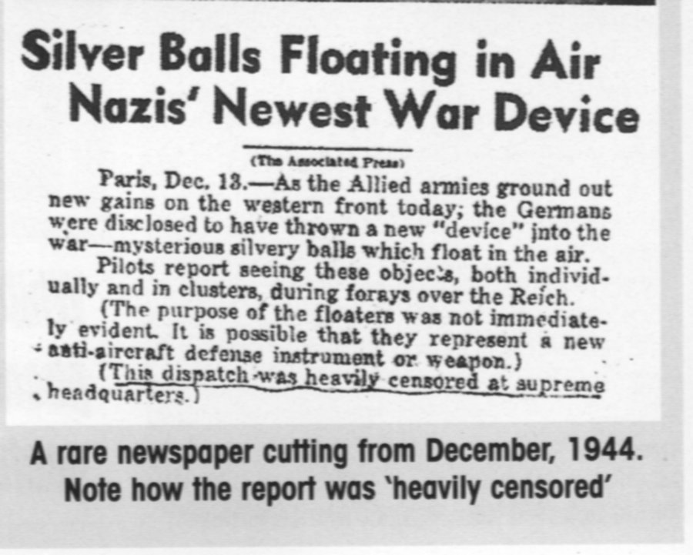
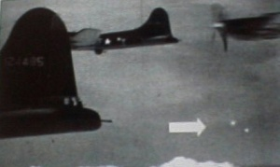
Part 5 - History of Nazi Occult Beliefs
WonderWeapons
Nazi UFO’s

Slide 22
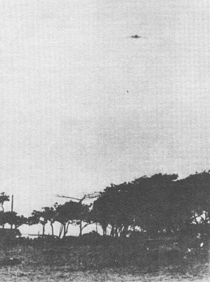
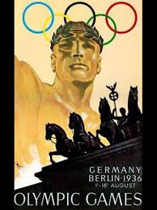
Part 5 - History of Nazi Occult Beliefs
WonderWeapons
1936 – Black Forest near Freiburg

Slide 23

Part 5 - History of Nazi Occult Beliefs
WonderWeapons
1936 –
Craft & bodies picked up by Himmler’s SS

Slide 24
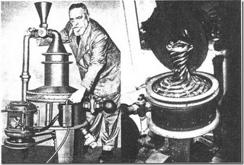
Part 5 - History of Nazi Occult Beliefs
WonderWeapons
Vicktor Schauburger – the Repulsine

Slide 25
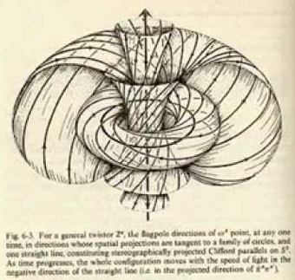
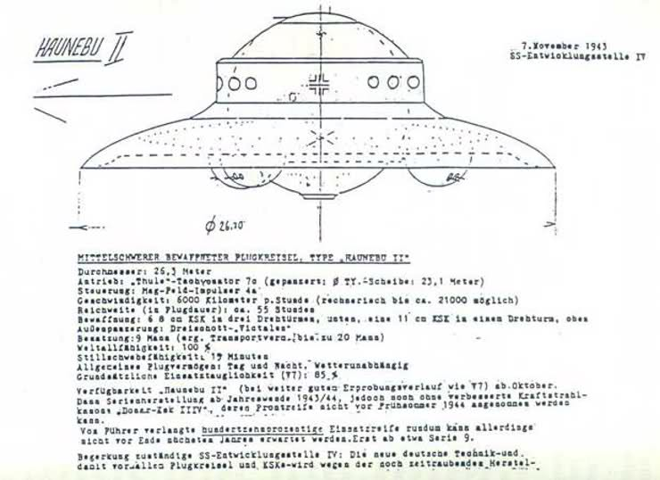
Part 5 - History of Nazi Occult Beliefs
WonderWeapons
Vortex Concept

Slide 26
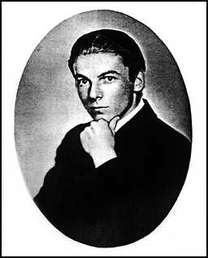
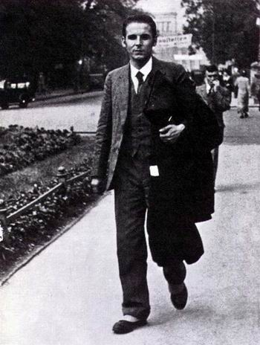
Part 6 – HITLER’S ASTROLOGER
The STORY
Karl Ernst Krafft
Famous 1933 Predictions
Pluto – WWII – Attempt – Summer, 1941 - End

Slide 27
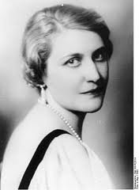
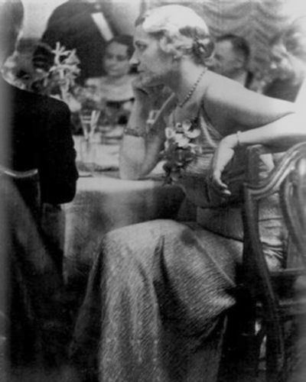
Part 6 – HITLER’S ASTROLOGER
The STORY
Magda Goebbels

Slide 28
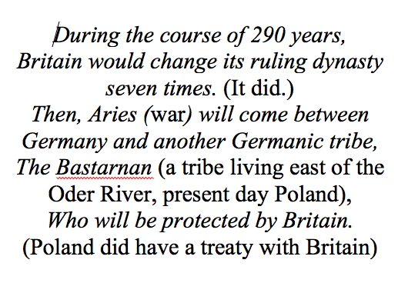
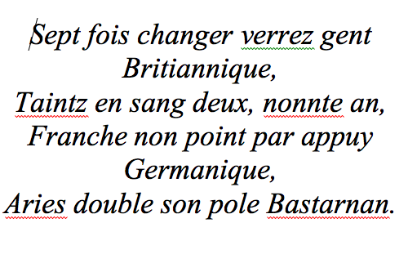
Part 6 – HITLER’S ASTROLOGER
The STORY
Magda Goebbels – Historian
Nostradamus Centuries III Quatrain 57

Slide 29
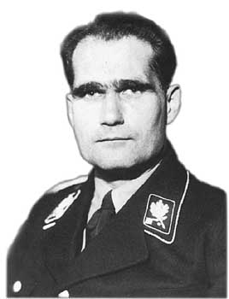
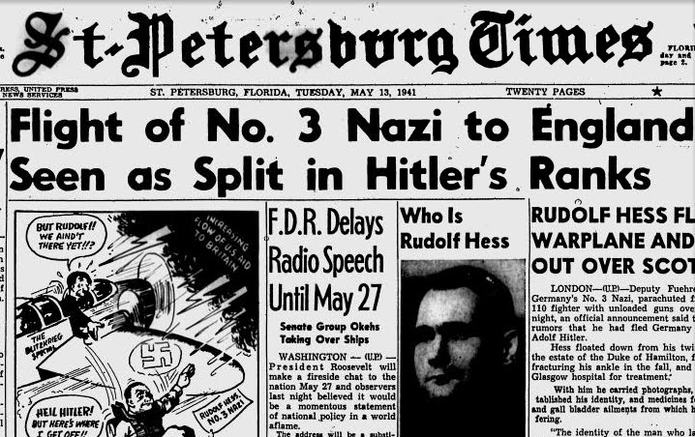
Part 6 – HITLER’S ASTROLOGER
The STORY
Rudolf Hess - astrologer

Slide 30
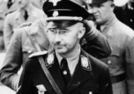
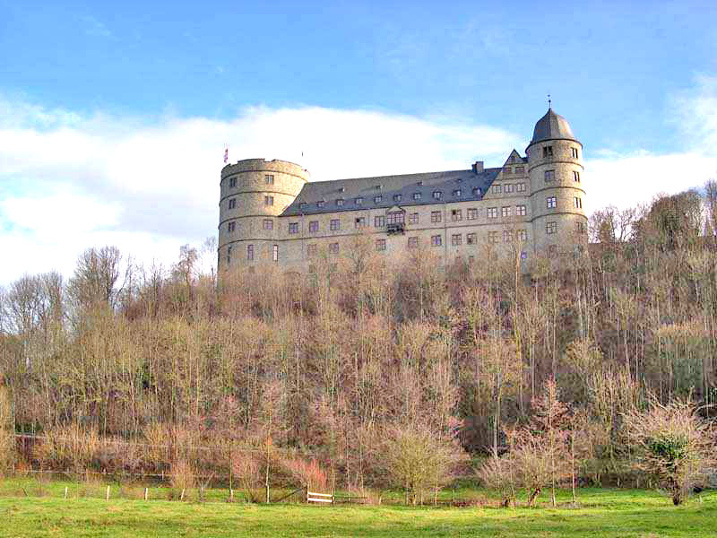
Part 6 – HITLER’S ASTROLOGER
The STORY
Himmler & the SS
The Occultist

Slide 31
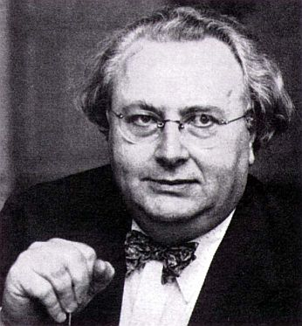
Part 6 – HITLER’S ASTROLOGER
The STORY
Ludwig von Wohl – Louis DeWohl
Two identities
Started the myth of Hitler using astrology…to get a job
British MI -5
Authored books creating the misconceptions

Slide 32
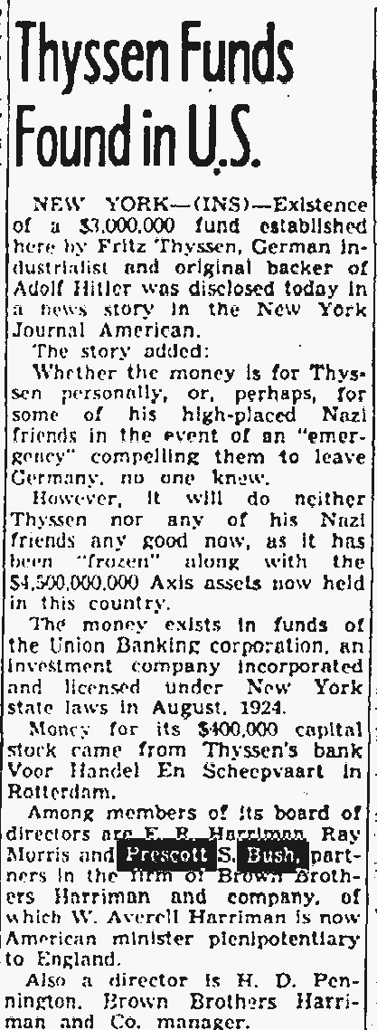
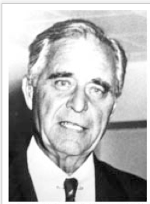
Part 6 – HITLER’S ASTROLOGER
The STORY
Prescott Bush

Slide 33
Part 6 – HITLER’S ASTROLOGER
The STORY
Karl Ernst Krafft’s
Work within the Third Reich & Black Sun

Slide 34
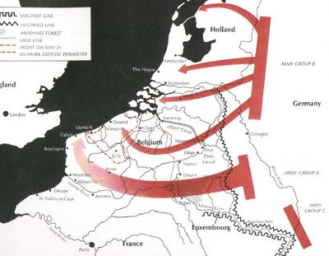

Part 6 – HITLER’S ASTROLOGER
The STORY
Krafft’s Work via Magda Goebbels

Slide 35
Part 6 – HITLER’S ASTROLOGER
The STORY
Krafft’s Work via Magda Goebbels

Slide 36
Part 6 – HITLER’S ASTROLOGER
The STORY
Krafft’s Work via Magda Goebbels
Phase 1
Phase 2
Phase 3

Slide 37
Part 6 – HITLER’S ASTROLOGER
The STORY
Krafft’s Work via Magda Goebbels
Phase 1
Phase 2
Phase 3
Magda’s Plan

Slide 38
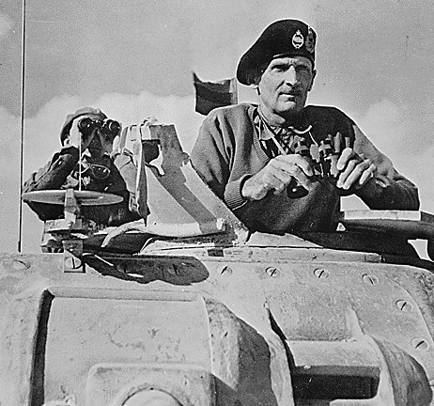
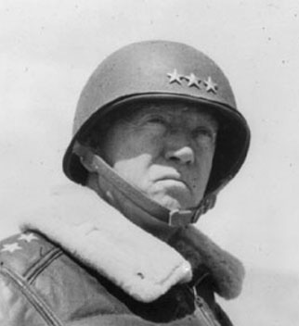
Part 6 – HITLER’S ASTROLOGER
The STORY
Krafft’s Work with German High Command

Slide 39
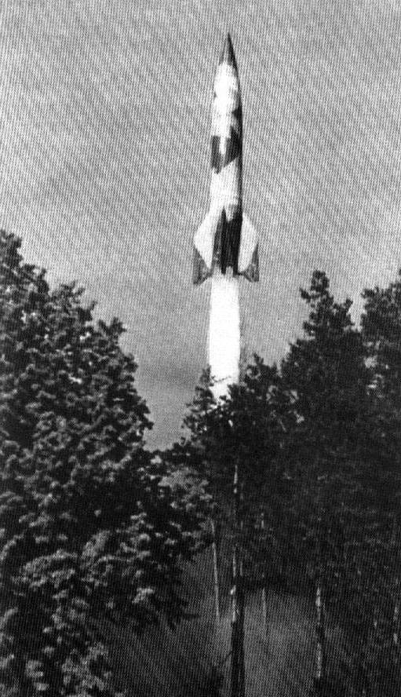
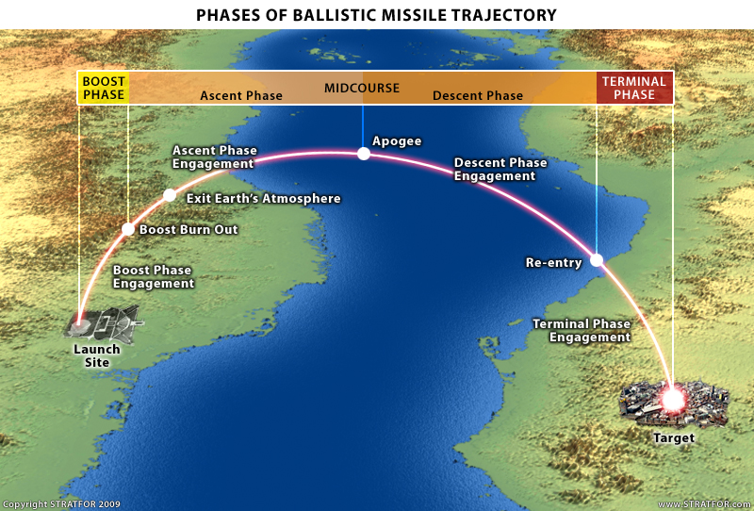
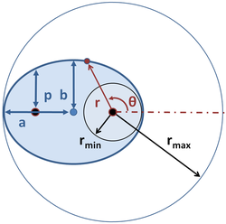
Part 6 – HITLER’S ASTROLOGER
The STORY
Krafft’s Work in Peenemünde

Slide 40
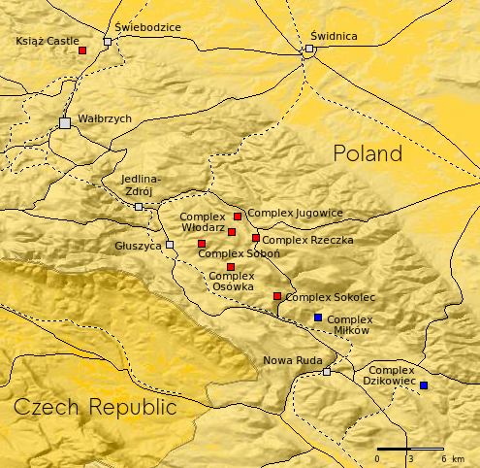

Part 6 – HITLER’S ASTROLOGER
The STORY
Krafft’s Work in Der Reise
“Giant” Complex in Owl Mountains The Bell
Counter rotating drives – Thorium 232 (mercury)

Slide 41


Part 6 – HITLER’S ASTROLOGER
The STORY
Krafft’s Work

Slide 42

Part 6 – HITLER’S ASTROLOGER
The STORY
Krafft’s Work

Slide 43

Part 6 – HITLER’S ASTROLOGER
The STORY
Karl Ernst Krafft’s End
On route to Buchenwald….
All workers & even scientists
at “Die Riesen” were killed…

Slide 44

Part 6 – HITLER’S ASTROLOGER
The STORY
The End…?
Maria Orzich -
Hamburg 1945, two days after Germany
surrendered, sent radio message to all Vril
members:
“niemand bleibt hier”

