Slide 1

Project Based Learning Project
(or how to manage teaching adults
in a post modern world)
by David Bryant Perkins

Slide 2
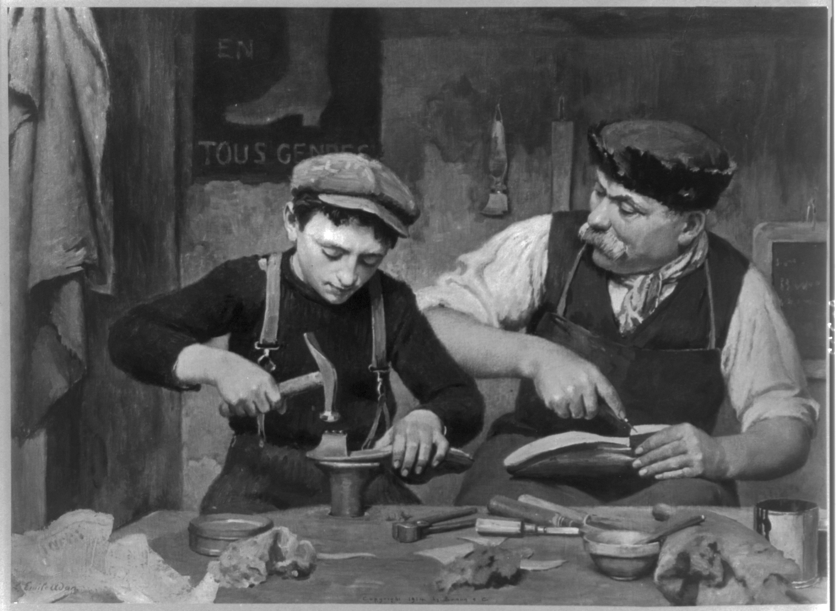
Project Based Learning
Want to learn by doing a project…?
First we need to know something:

Slide 3
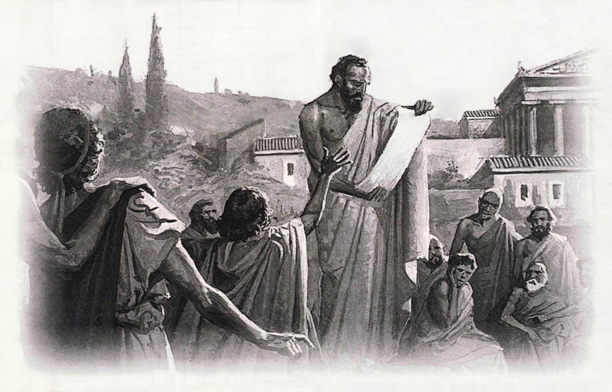
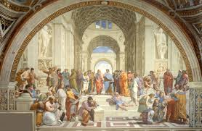

Project Based Learning
What age are you in…?
(Philosophically speaking, that is…)
Pre-Socratic
ANCIENT
Medieval

Slide 4
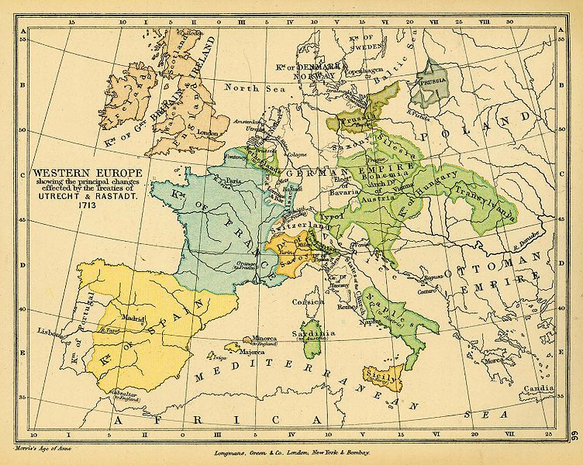
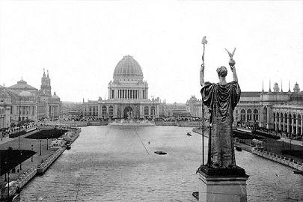

Project Based Learning
Pre-Socratic
ANCIENT
Medieval
Philosophical Learning Ages
Modern
Contemporary
Post Modern
21st Century
19th Century
17th Century

Slide 5
Project Based Learning
…and just because it’s 2015 doesn’t mean you are automatically learning/doing/teaching/ or working in a Post Modern environment.
21st Century

Slide 6
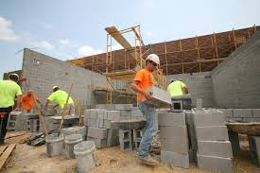
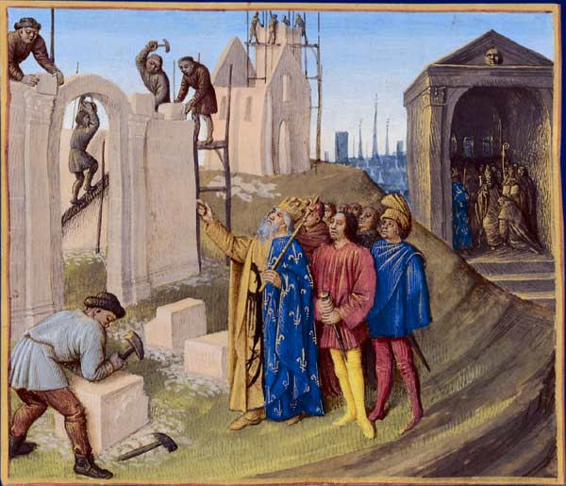
Project Based Learning
…you may be living in 2015…however
your organization may still be in the Middle ages…

Slide 7
Project Based Learning
For example, every school in the USA has learning & teaching fundamentals dating back to the 1890’s…

Slide 8
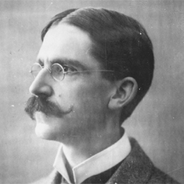
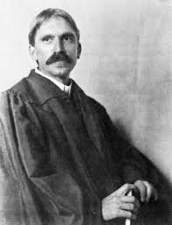
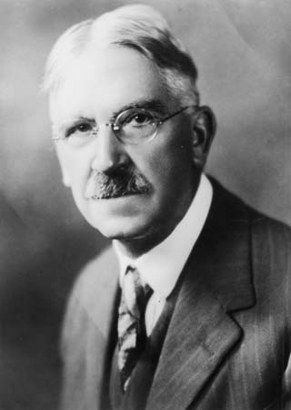
Project Based Learning
Mainly from this guy:
1859 - 1952

Slide 9
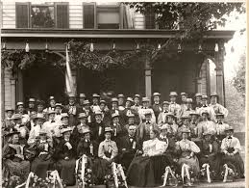
Project Based Learning
A high school teacher in Oil City, Pennsylvania
1881 - 1983

Slide 10
Project Based Learning
Ph.D.
Johns
Hopkins
1884

Slide 11
Project Based Learning
Professor
University
of
Michigan
1884 - 1894

Slide 12
Project Based Learning
Professor
University
of
Chicago
1894 - 1904

Slide 13
Project Based Learning
President
of the American
Psychological
Association
1899

Slide 14
Project Based Learning
President
of the American
Philosophical
Association
1905

Slide 15
Project Based Learning
…and thanks to him:
Numerous books, papers, articles:
The School & Society (1899)
Thought & its Subject-Matter (1903)
Studies in Logical Theory (1903)
Democracy and Education (1916)
Human Nature & Conduct (1922)
1884 - 1952

Slide 16

Project Based Learning
Some of his thoughts:
1859 - 1952

Slide 17
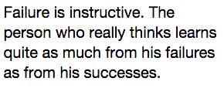
Project Based Learning
Some more of his thoughts:
1859 - 1952

Slide 18

Project Based Learning
Even some more of his thoughts:
1859 - 1952

Slide 19

Project Based Learning
Which expressed his political views:
1859 - 1952

Slide 20
Project Based Learning
All those wonderful contributions, thanks to
the Father of American Education:
1859 - 1952

Slide 21
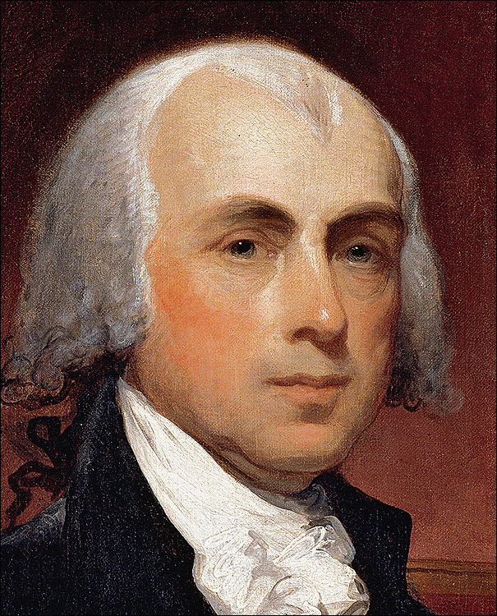
Project Based Learning
Who was inspired by how James Madison researched each prior age to create the
Government
of the United States
Wow!
Great
Idea!!!

Slide 22
Project Based Learning
Remember, among other things, he was also interested in:
Government

Slide 23
Project Based Learning
So, he set out to see the AGES through the lens of
EDUCATION

Slide 24
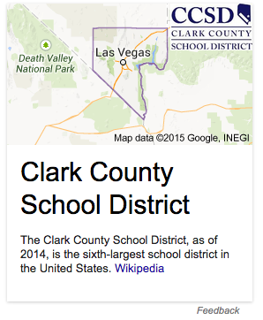
Project Based Learning
Which is something we can do here at CCSD…

Slide 25
Project Based Learning
(Well… actually)
Just what age
are we in….?

Slide 26
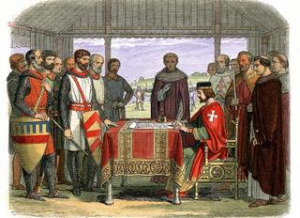
Project Based Learning
Medieval
Age…?

Slide 27
Project Based Learning
Perhaps we made it to the
Modern era?

Slide 28
Project Based Learning
Or maybe we go further back…?

Slide 29
Project Based Learning
Actually, a little bit of each age is in CCSD…

Slide 30
Project Based Learning
Even this guy:
1859 - 1952

Slide 31
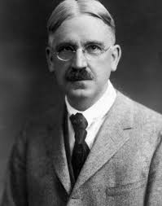
Project Based Learning
For many educational theories
used in America today are in his:
My Pedagogic Creed (1897)

Slide 32

Project Based Learning
A theme he created by
Taking something
from this time…
ANCIENT
& applying it…
Contemporary
…to his own time
by
understanding
ANCIENT
LITERATURE:

Slide 33
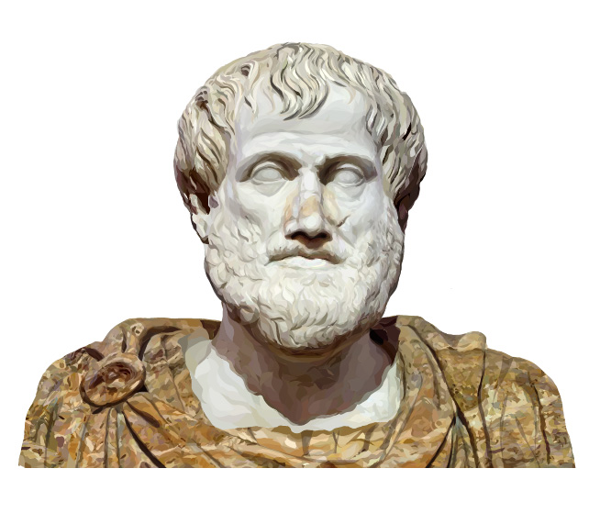
Project Based Learning
He took this statement:
“Gaining knowledge through & in nature can also obtained by exercise & practice of the mind applied to the subject at hand.”
- Aristotle (384 BC – 322 BC)
and
turned it into
this statement:

Slide 34
Project Based Learning
“Learning by Doing”
(1904)

Slide 35
Project Based Learning
Now is this:
“Gaining knowledge through & in nature can also be obtained by exercise & practice of the mind applied to the subject at hand.”
Really any different?
Than this:
“Learning
by
Doing”

Slide 36
Project Based Learning
NO
“Gaining knowledge through & in nature can also be obtained by exercise & practice of the mind applied to the subject at hand.”
Any
similarities & differences
YOU
see
between these two???
“Learning
by
Doing”
ANCIENT
Contemporary
YES
500 BC 19th Century

Slide 37
Project Based Learning
Asking that question had him ask questions of
ALL THE AGES…

Slide 38
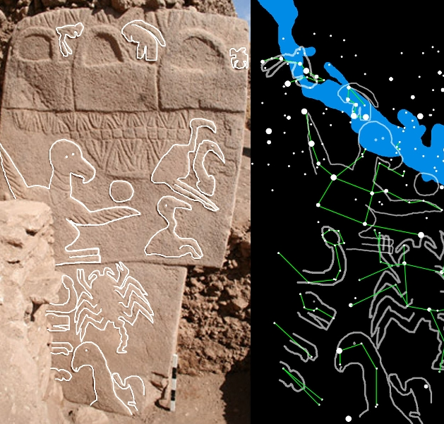
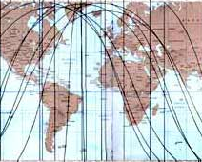
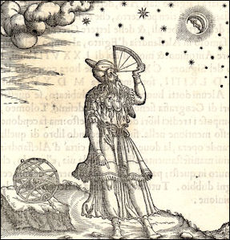
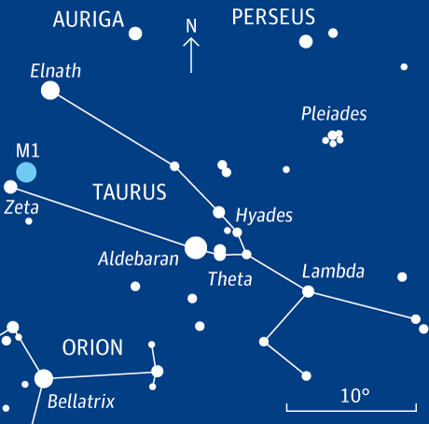
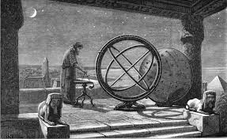
Project Based Learning
HE FOUND ALL THESE AGES WERE SIMILAR

Slide 39
Project Based Learning
HE FOUND ALL THESE AGES WERE SIMILAR

Slide 40
Project Based Learning
HE FOUND ALL THESE AGES WERE SIMILAR

Slide 41
Project Based Learning
HE FOUND ALL THESE AGES WERE SIMILAR

Slide 42
Project Based Learning
HE FOUND ALL THESE AGES WERE SIMILAR

Slide 43
Project Based Learning
HE FOUND ALL THESE AGES WERE SIMILAR

Slide 44
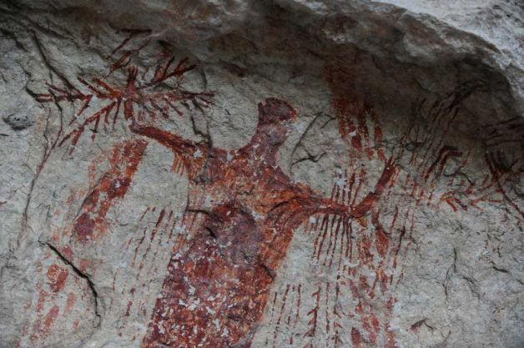

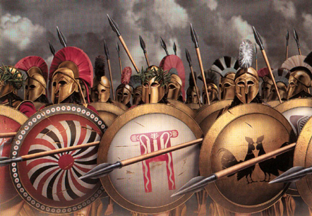
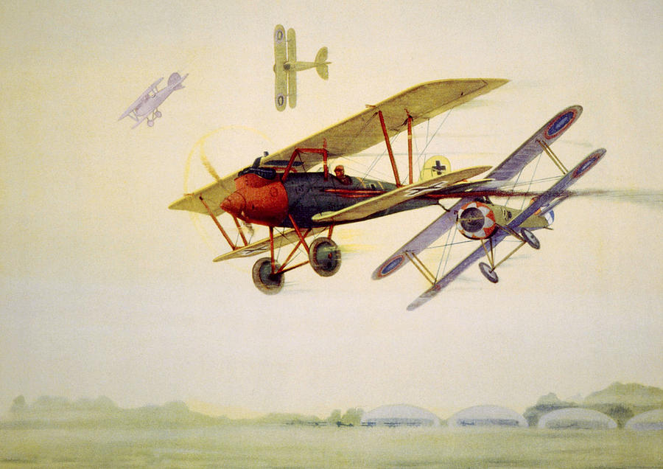
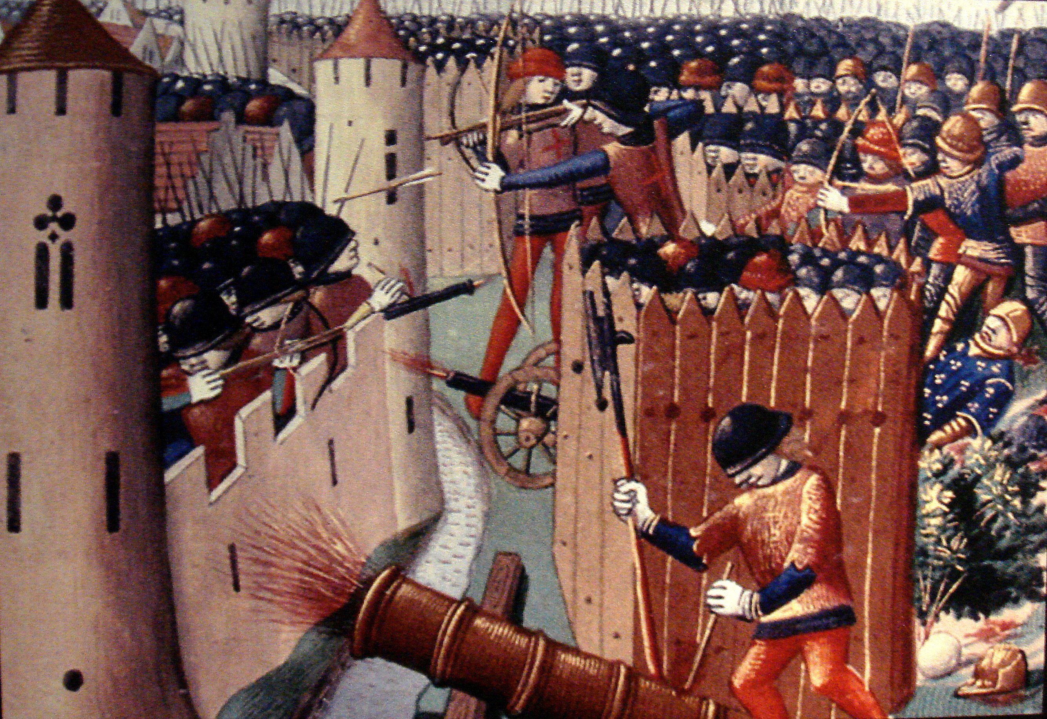
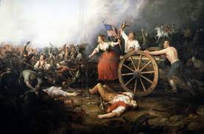
Project Based Learning
AND ALL THESE AGES WERE DIFFERENT

Slide 45
Project Based Learning
AND ALL THESE AGES WERE DIFFERENT

Slide 46
Project Based Learning
AND ALL THESE AGES WERE DIFFERENT

Slide 47
Project Based Learning
AND ALL THESE AGES WERE DIFFERENT

Slide 48
Project Based Learning
AND ALL THESE AGES WERE DIFFERENT

Slide 49
Project Based Learning
AND ALL THESE AGES WERE DIFFERENT

Slide 50
Project Based Learning
HOWEVER,
A few were
MORE SIMILAR
to each other
=
ANCIENT
Contemporary
500 BC 19th Century

Slide 51
Project Based Learning
For example,
These two are
more similar
to each other
than these two:
ANCIENT
Contemporary
500 B.C. 19th Century
Medieval 12th Century Modern 17th Century

Slide 52
Project Based Learning
ANCIENT
Contemporary
500 BC
Even though they
are
farther apart
in time
than these:
19th Century
Modern 17th Century
Medieval 12th Century

Slide 53
Project Based Learning
What are some ways these ages are closer?
ANCIENT
Contemporary
500 BC
19th Century

Slide 54
Project Based Learning
Democracy & Education (1916)
ANCIENT
Contemporary

Slide 55
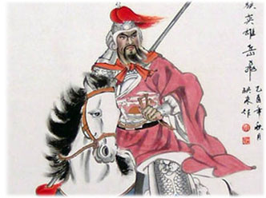
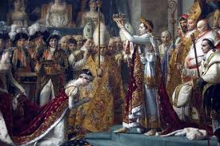
Project Based Learning
Not much democracy going on in any these ages
Medieval 12th Century Modern 17th Century

Slide 56
Project Based Learning
In seeing how education changes in each age…

Slide 57
Project Based Learning
He saw how each age changes the human condition…

Slide 58
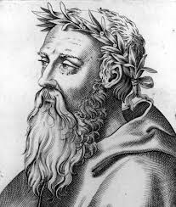
Project Based Learning
Which is nothing new, even in pre-ancient times, educators knew: society was always changing:
Heraclitus (535 – 475 BC)
knew it:
“Everything changes and nothing remains still…you cannot step twice into the same stream”
(Robinson, 1987)

Slide 59
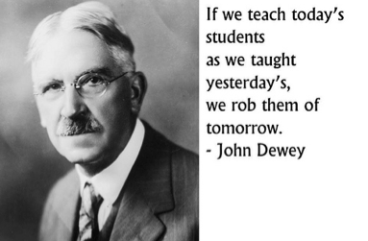

Project Based Learning
But he saw the need for change as a vision
- The School & Society
- 1899

Slide 60
Project Based Learning
A vision on what changes
we need for the:
21st Century
- The School & Society
- 1899

Slide 61
Project Based Learning
A vision on what changes
we need for the:
21st Century
- The School & Society
- 1899

Slide 62
Project Based Learning
A vision on what changes
we need for the:
21st Century
- The School & Society
- 1899

Slide 63

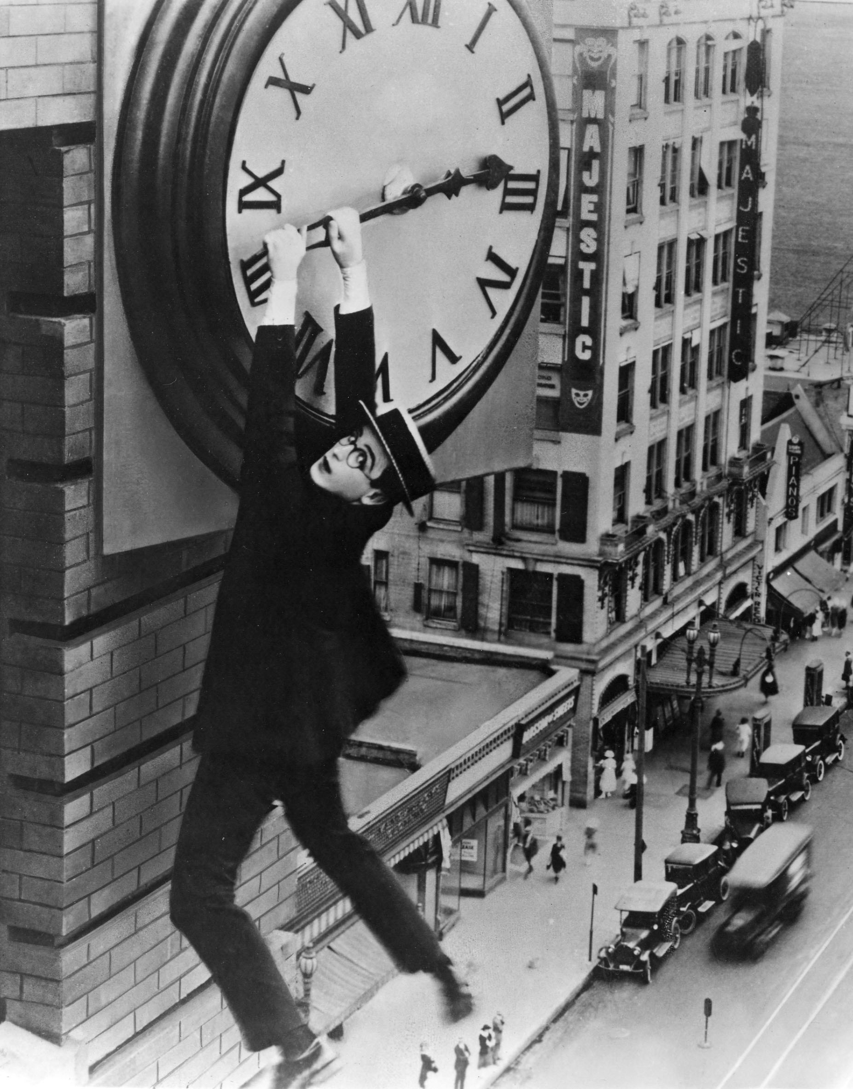
What changes?
How do we
see,
know,
understand,
and
keep up with
such changes?

Slide 64

Project Based Learning
We make these:
DO THEY WORK…?

Slide 65
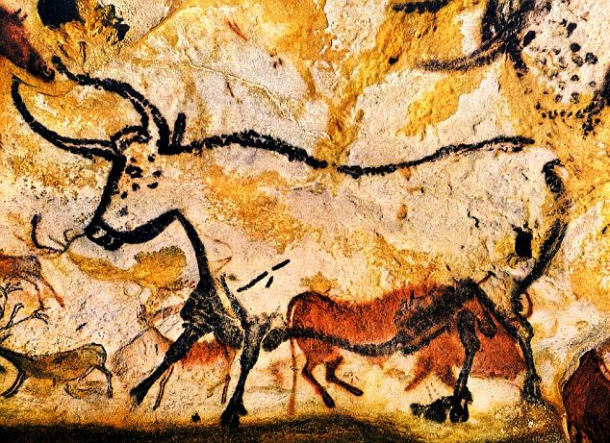
Project Based Learning
Question for you to decide – one observation:

Slide 66


Project Based Learning
Let’s go back to the mission statement:
Policy:
NO CELL PHONES
IN THE CLASSROOM

Slide 67
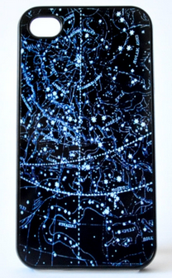
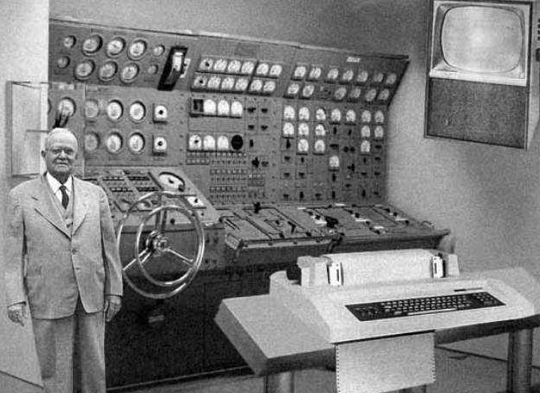
Project Based Learning
Mission statement:
Policy:
actually
takes away personal, more powerful technology – forcing kids to use
the school’s (outdated) technology – whenever there’s a chance to do that…
Automatically allowing students LESS time on technology

Slide 68

Project Based Learning
…?
LET THE KIDS TEACH US ON THAT ONE…

Slide 69
Project Based Learning
So what AGES are CCSD’s policies…?

Slide 70
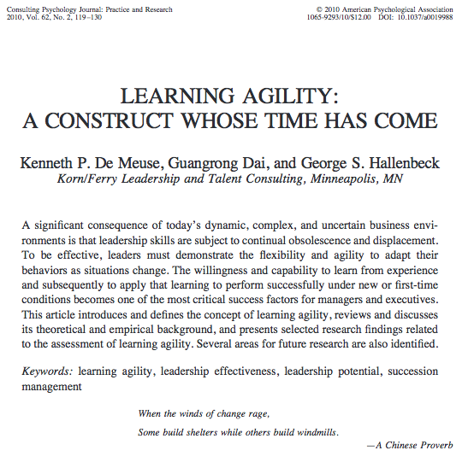
Project Based Learning
There’s an app for that!
Clark & Gottfredson
(2008):
Learning Agility:
System to
measure
organizational
policies
by
stages

Slide 71
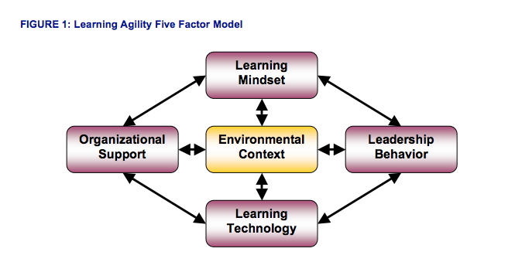
Project Based Learning
Learning Agility Stages look like this:

Slide 72
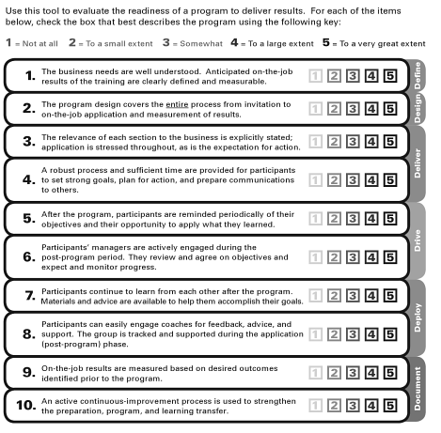
Project Based Learning
Clark and Gottfredson’s (2008) Learning Agility
Stage ‘worksheet’ looks like this:

Slide 73
Project Based Learning
Clark and Gottfredson’s (2008) Learning Agility Stage ‘worksheet’ applied to CCSD looks like this:
√

Slide 74
Project Based Learning
RESULTS:
Learning Agility Stage Worksheet (Clark & Gottfredson, 2008)

Slide 75
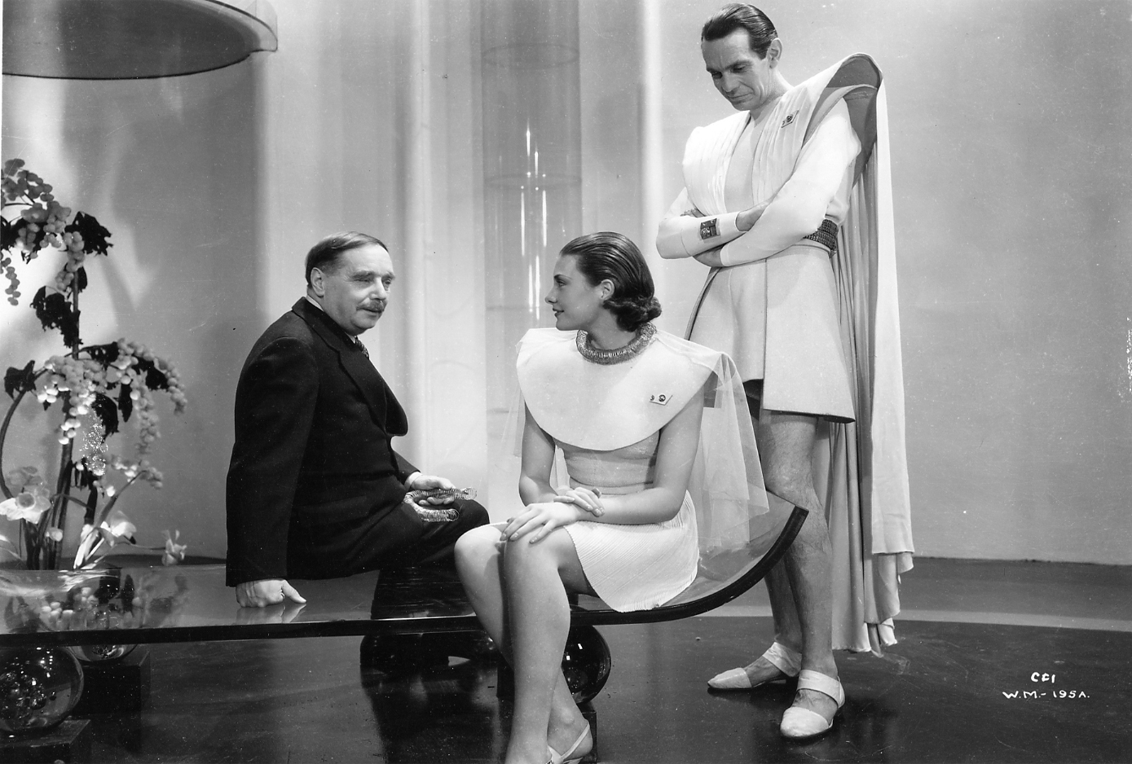
Project Based Learning
Well, at least on the surface we look modern…

Slide 76
Project Based Learning
There is ONE theory CCSD
IS
Post Modernism
21st Century

Slide 77
Project Based Learning
…and that theory is:

Slide 78
Project Based Learning

Slide 79
Project Based Learning
…well, yea, that’s it……….

Slide 80
Project Based Learning

Slide 81
Project Based Learning
…yea…that…up there….

Slide 82
Project Based Learning
…it’s what this lecture has
been ABOUT……….!

Slide 83
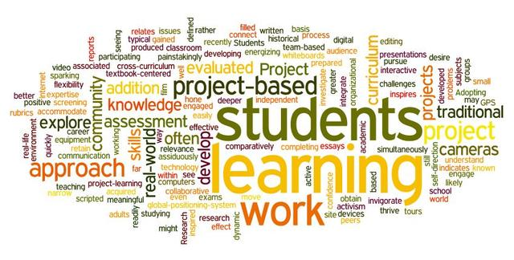
Project Based Learning
It’s what we’ve been talking about the entire time…(well, sort of)

Slide 84
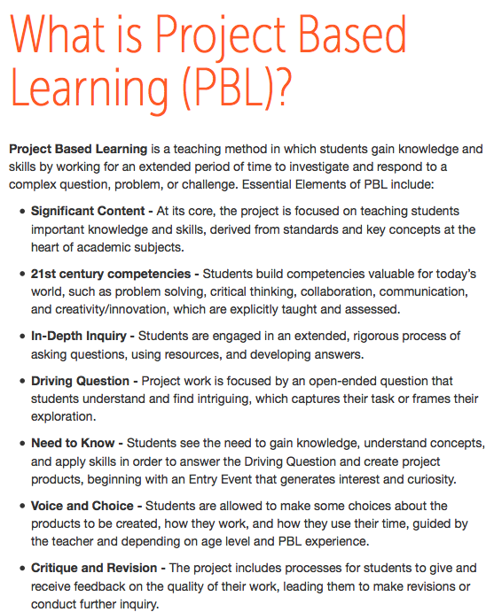
(Chun-Ming, Gwo-Jen,
& Iwen, 2012)

Slide 85

…more specifically…
“…students gain knowledge & skills by working for an extended period of time..”

Slide 86
SOUND FAMILIAR…?
“Learning by Doing”
(1904)

Slide 87
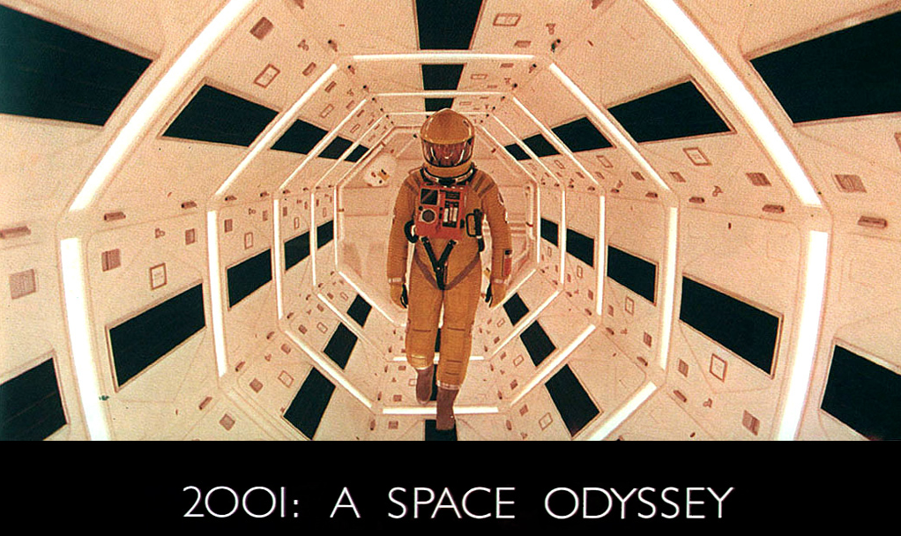
Let’s LEARN a Project-based Learning example by DOING one…

Slide 88
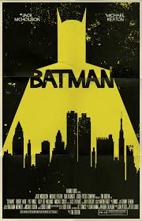

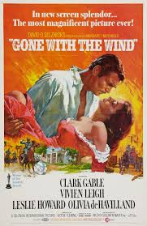

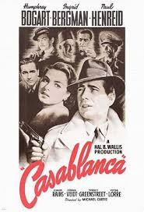
Project Based Learning
By making one
of these:

Slide 89
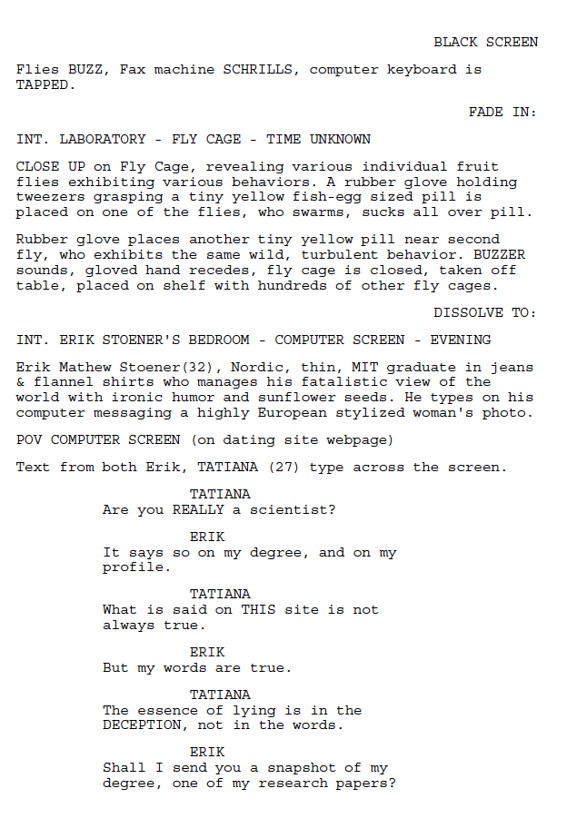
Project Based Learning
Well, we’ll
start by
learning to
write this:

Slide 90
Project Based Learning
The Screenplay
But we’ll do it in a multimedia, mathematical way, in lines of Milovanović, Obradović, & Milajić, A. (2013)

Slide 91
Project Based Learning
Screenplays
are where all
such movies
start:

Slide 92
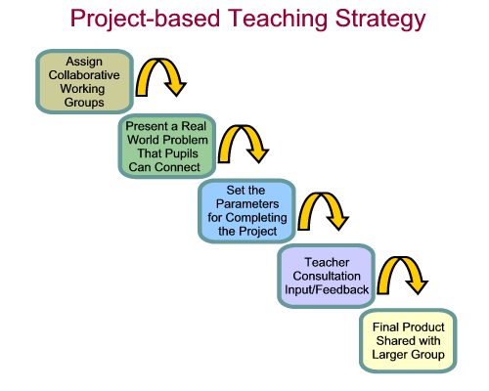
Project Based Learning
Before we do, let’s reflect a bit on some Project Based Learning projects you may have done, or been exposed to, perhaps without even realizing it…
(Pieratt, 2010)

Slide 93
Project Based Learning References
Clark, T. R. & Gottfredson, C. A. (2008). In search of learning agility, assessing progress from 1957 to 2008. Retrieved from http://www.elearningguild.com/content.cfm?selection=doc. 1054
Chun-Ming, H., Gwo-Jen, H., & Iwen, H. (2012). A Project-based Digital Storytelling Approach for Improving Students' Learning Motivation, Problem-Solving Competence and Learning Achievement. Journal Of Educational Technology & Society, 15(4), 368-379.
Dewey, J. (1897). My pedagogic Creed. Chicago: University of Chicago Press
Dewey, J. (1899). The school and society. Chicago: University of Chicago Press
Dewey, J. (1903). Studies in logical theory. Chicago: University of Chicago Press
Dewey, J. (1916). Democracy & education. Chicago: University of Chicago Press
Dewey, J. (1922). Human nature & conduct. Chicago: University of Chicago Press
Pieratt, J. R. (2010). Advancing the ideas of john dewey: A look at the high tech schools. Education & Culture, 26(2), 52-64.
Robinson, T.M. (1987). Heraclitus Fragments: A text and translation with commentary. Toronto: University of Toronto Press. ISBN 0-8020-6913-4
Milovanović, M., Obradović, J., & Milajić, A. (2013). Application of interactive multi-media tools in teaching mathematics – Examples of lessons from geometry. Turkish Online Journal Of Educational Technology, 12(1), 19-31.

